Slide 1
Program flow
2019-11-13
Göteborg

Slide 2
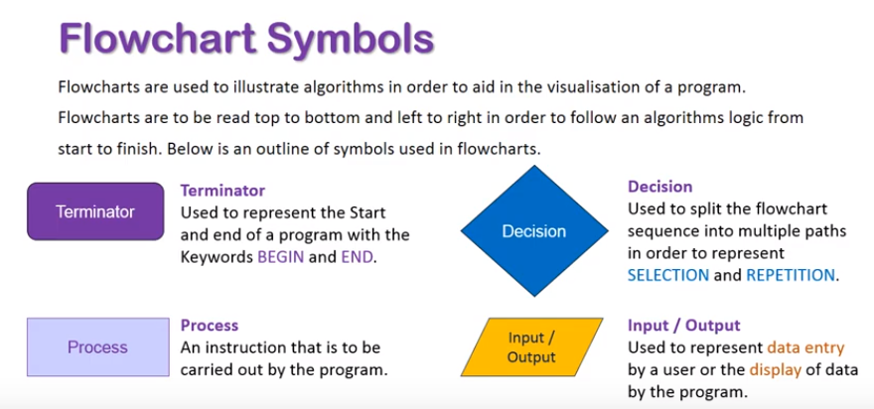
Flow charts
Helps us understand better how the execution of the program is performed.

Slide 3
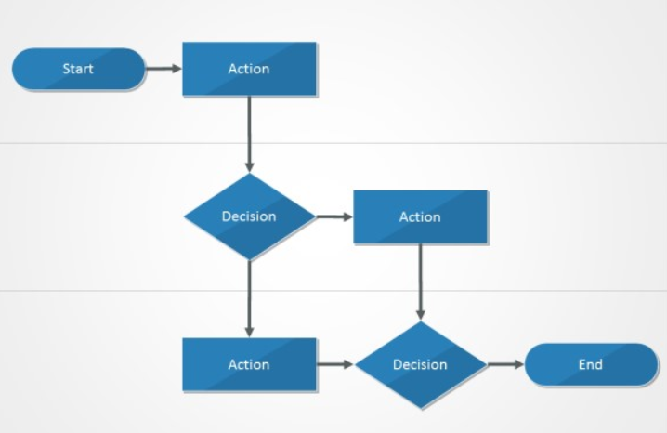
Flow charts
Using arrows, we can visualize the program flow. Action represents here both a Process (some code to be executed) and an Input/Output

Slide 4
Flow charts
The arrows going out from decision show us the different paths our program execution can take.

Slide 5
Flow charts
That decision making can be performed in C# using an if-statement.
We say, if the expression inside is true, then we go one way, otherwise…

Slide 6
Flow charts
We can chose to do nothing, or…
Using an Else statement, we can performa a new branching of the program flow.

Slide 7
Conditional statements
Such as If-else must be evaluated
The result is always TRUE or FALSE.
When we create the condition (the expression to be evaluated), we are using something called comparison operators. The most used comparison operators are:
== (is equal to)
<= (is less then or equal to)
>= (is greater than or equal to)
!= (is not equal to)

Slide 8
Conditional statements
A common mistake made by programmers is to forget that the equality operator requires 2 symbols of ”=”.:
So the correct way to write the condition would be
If (A == B)
{
//do something
}

Slide 9
Conditional statements
Demo time (working with boolean data type and truth tables)

